Slide 1
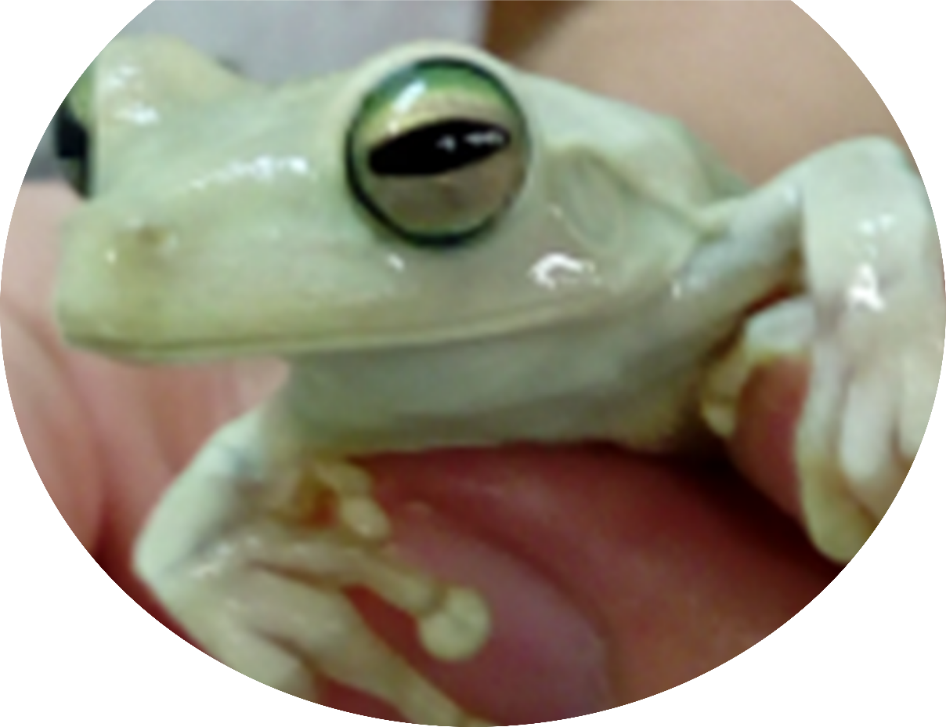
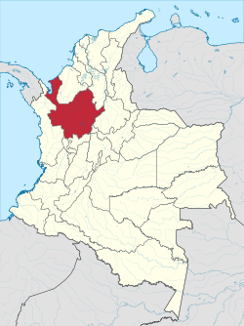
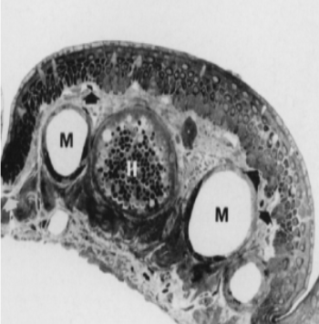
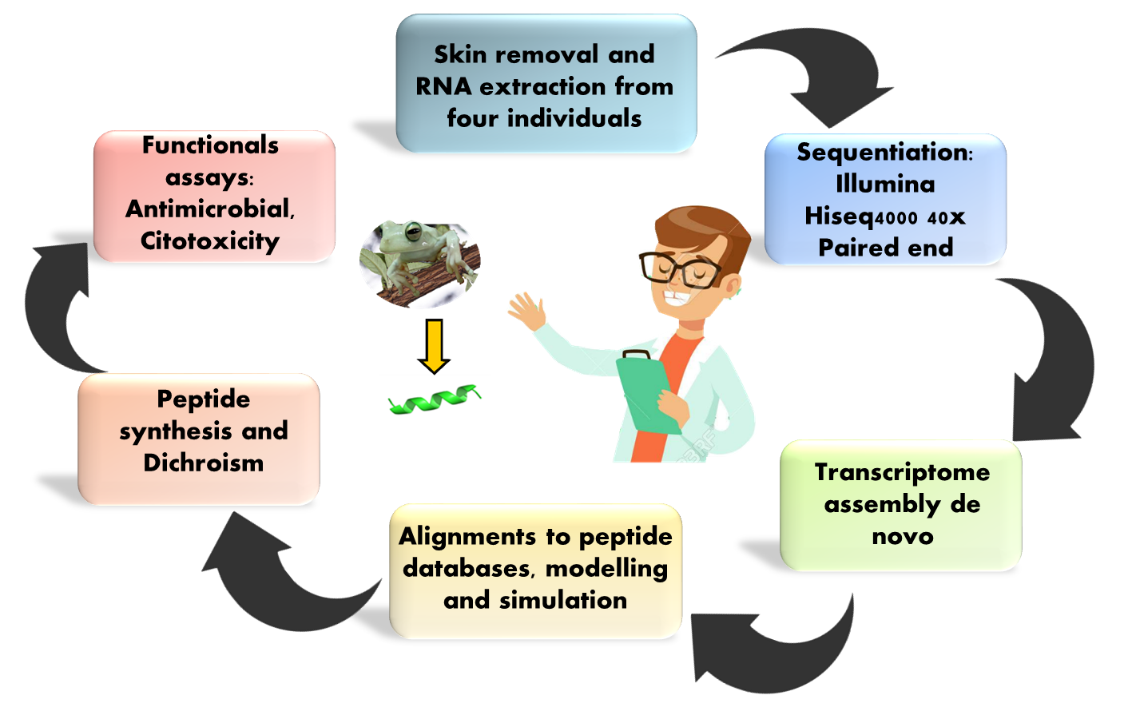
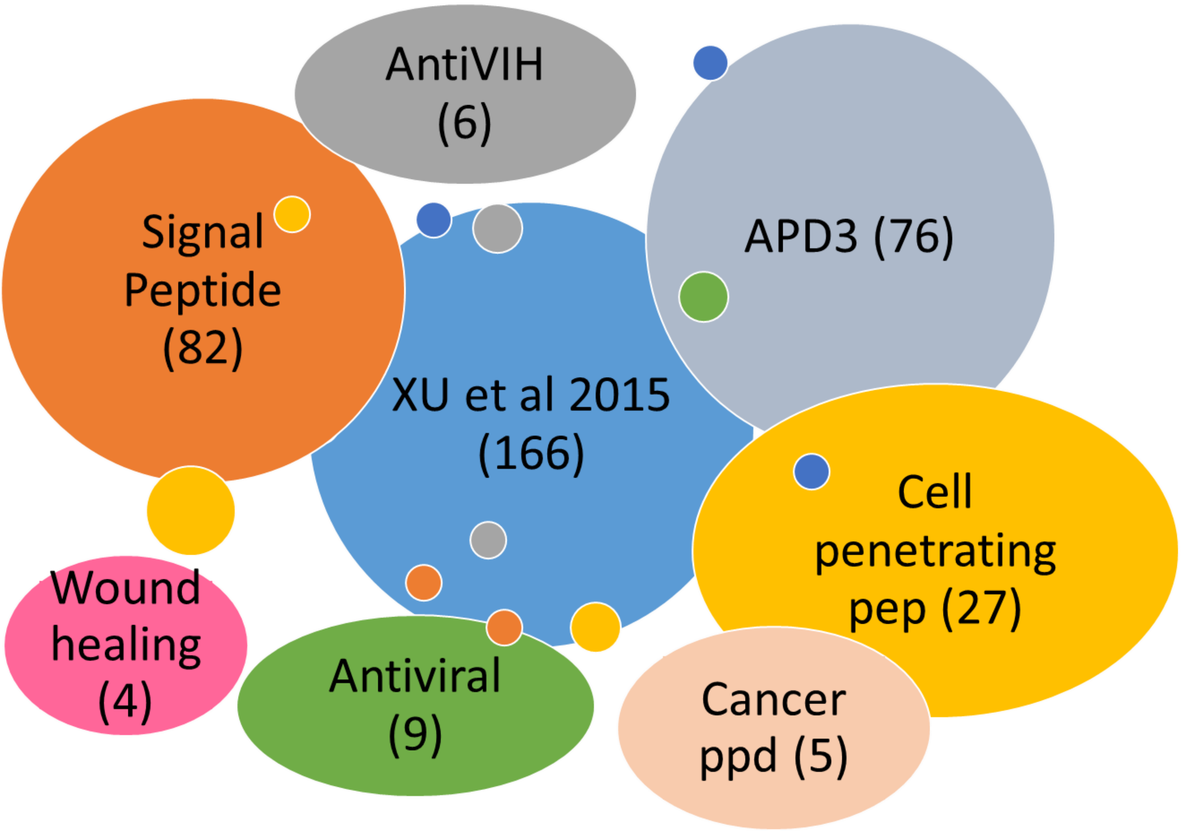
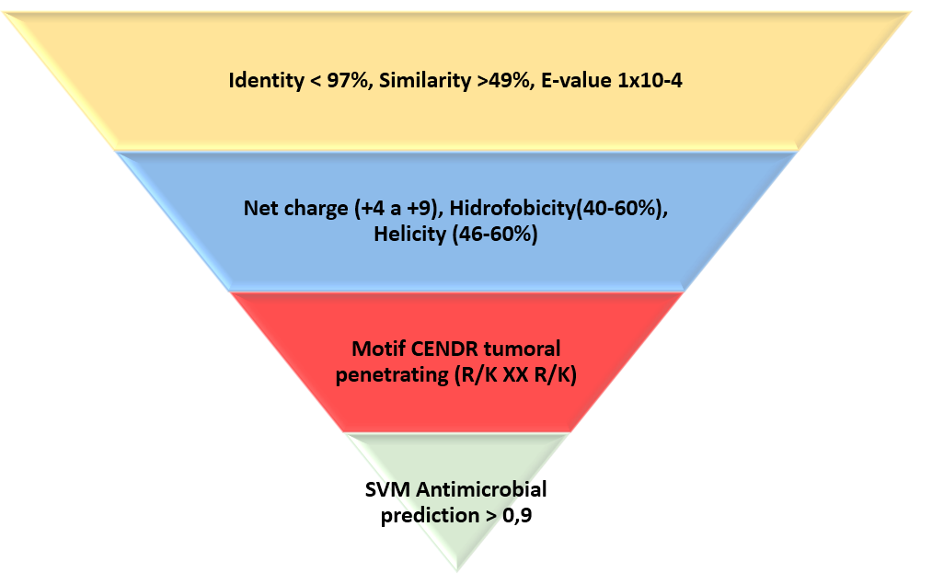
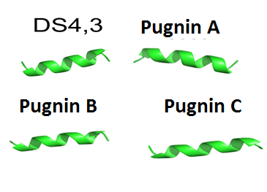
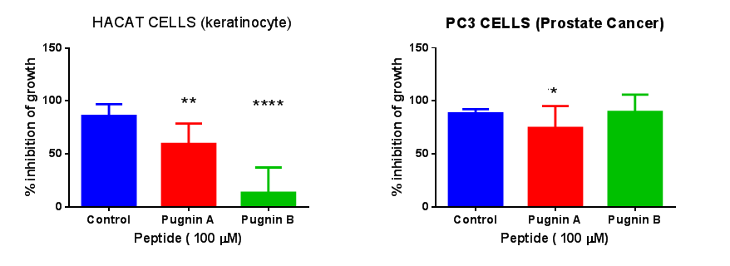
NEW PEPTIDES FROM DE NOVO ASSEMBLY TRANSCRIPTOME OF THE SKIN OF TREEFROG BOANA PUGNAX
Liscano y. Arenas CM, Gúzman f, Pickholz M, Delgado JP
Grupo Genética, Regeneración y Cáncer
Universidad de Antioquia, Colombia
JEAN.DELGADO@udea.edu.co
Background
Methods
Colombia is the second country with the highest biodiversity in the world, currently 56,343 species have been reported among which there are 803 species of amphibians, of which 367 are endemic and the highest percentage (93%) represents the order of anurans. To date, 216 species of anurans have been reported in the department of Antioquia, including the tree frog Boana pugnax, whose importance in this study lies in their skin, because throughout the evolution of this tissue has become the first line of defense against microorganisms and predators given its ability to secrete an exudate with a wide bioactive molecules that protect it, for example peptides that are important in the pharmaceutical market, as they not only have a broad spectrum of activities but also generate low bacterial resistance compared to conventional antibiotics. The objective of this work was the identification of new peptides candidates with antimicrobial and antitumor activities from transcriptome of the skin.
Antioquia, Colombia, South America
H: Granoulous gland M: Mucous gland in dorsal skin of frogs
Results
Table 1. Summary of the assembled data of B.pugnax transcriptome
PRIOR TO DE-NOVO TRANSCRIPTOME ASSEMBLY
Length of raw reads (bp) | 101.0
Total number of raw reads | 809,394,848
Total number of cleaned reads | 573,994,007
AFTER DE-NOVO TRANSCRIPTOME ASSEMBLY
Total number of all transcripts | 2,830,052
GC-content of all transcripts (%) | 43.58
Average transcript length (bp) | 279.0
Total number of predicted proteins (possible ORFs) | 192,434
BUSCO Vertebrata (%) | 87.7
BUSCO Metazoa (%) | 98.2
BUSCO Eukaryota (%) | 99.0
Fig 3. Pugnins found from homolgous peptide DS4,3 and (modelling by threading /AB initio)
Fig 1. Peptide Databases used to find 375 peptides from skin transcriptome
Fig 2. Filter to find best AMP with Antitumoral motif candidates
Table 2. Comparison between pugnins in a relation to Hemolytic concentration 50 (HC50), Minimum inhibitoriy concentration 90 (MIC90) in E.coli and physicochemical properties.
Peptide | Similarity (%) | Identity (%) | Net charge | Hydrophobicity (%) | HC50 (uM) | MIC 90 (uM) E.coli ATCC 25922
DS4,3 original | N/A | N/A | 5 | 39.92 | N/A | N/A
Pugnin A | 92,3 | 61,5 | 5 | 43.36 | 122 | 33,33
Pugnin B | 92,3 | 61,5 | 4 | 46.62 | 62 | 33,33
Pugnin C | 92,3 | 53,8 | 5 | 40.81 | >1000 | >100
Fig 4.Molecular dynamics of pugnin A on a membrane that emulates the phospholipids of the membrane of the E.coli strain. The image A is the composition of the system, composed by water on the outside, the types of phospholipids POPE (phosphatidylethanolamine) and POPG (phosphatidylglycerol) in 4: 1 ratio. The image B shows water samples and the phosphates of the phospholipids that they are brought into the interior of the membrane. The image C is revealed as the peptide pulls inward the phosphates of the phospholipids
Fig 6. Citotoxicity assay with MTT in HACAT and PC3 cells. Both peptides are citotoxic for PC3 cells at 100uM. But nevertheless Pugnin A is also toxic for HACAT cells
Fig 5 Circular dichroism of three pugnins in TFE30%. They all form alpha heliix.
Conclusions
Future Directions
References
Acknowledgments
The result of this work is not the assembly of the first de novo transcriptome of the skin of the Boana pugnax frog, but to obtain two new peptides derived from the peptide DS3,4 which is a cell penetrating peptide, Pugnin A and B. These had both antimicrobial activity against E. coli and cytotoxicity against PC3 cells. This work will encourage the use of bioinformatics tools to design new peptides starting from few samples, avoiding damage to the species and its environment. Besides, these results will improve the understanding of the species and its habitat, as well as contribute to the strengthening of protected areas in the Colombian territory.
Perform cell cycle and viability analysis in PC3 cells using flow cytometry and fluorescent labeling of the peptide and the membrane using a fluorescence microscope in order to better understand the mechanism of action of the peptides
Grabherr, M. G., Haas, B. J., Yassour, M., Levin, J. Z., Thompson, D. A., Amit, I., … Regev, A. (2011). Trinity: reconstructing a full-length transcriptome without a genome from RNA-Seq data. Nature Biotechnology, 29(7), 644–652.
Gutierrez, L.M, Vera, N.E, Perez, J.N. (2016). Entorno de trabajo bioinformático para RNAseq. Editorial UD. 33-43
Magalhães, B. S., Melo, J. A. T., Leite, J. R. S. A., Silva, L. P., Prates, M. V., Vinecky, F., … Bloch, C. (2008). Post-secretory events alter the peptide content of the skin secretion of Hypsiboas raniceps. Biochemical and Biophysical Research Communications, 377(4), 1057–1061
Fanny Gúzman, University Pontificia Católica of Valparaiso
Monica Pickholz, University of Buenos Aires
Octavio Franco, University Catholic of Brasilia
Gustavo Agamez, University of Antioquia
Minambiente for delivering the contract on genetic access for scientific reseaech for non-commercial profit, number 119 of 2015
Octavio Franco, University Catholic of Brasilia
Gustavo Agamez, University of Antioquia
n, University Catholic of Chile
Notes:
Para cambiar este póster, sustituya el contenido de muestra por el suyo. Si prefiere empezar de cero, use el botón Nueva diapositiva de la pestaña Inicio para insertar una página nueva y luego escriba el texto y el contenido en los marcadores de posición vacíos. Si necesita más marcadores para títulos, subtítulos o texto del cuerpo, copie cualquiera de los marcadores actuales y arrastre el nuevo hasta esa posición.

